Slide 1
CS404 : Parallel Processing (21/22)
Practical Session 1

Slide 2
Server architectures
Single-Tenant Server | Multi-Tenant Server
physical server or a virtual machine instance that is exclusively allocated to a single user or customer. | server where resources are shared among multiple users or tenants.
Has high degree of isolation. | Has high degree of resource sharing.

Slide 3
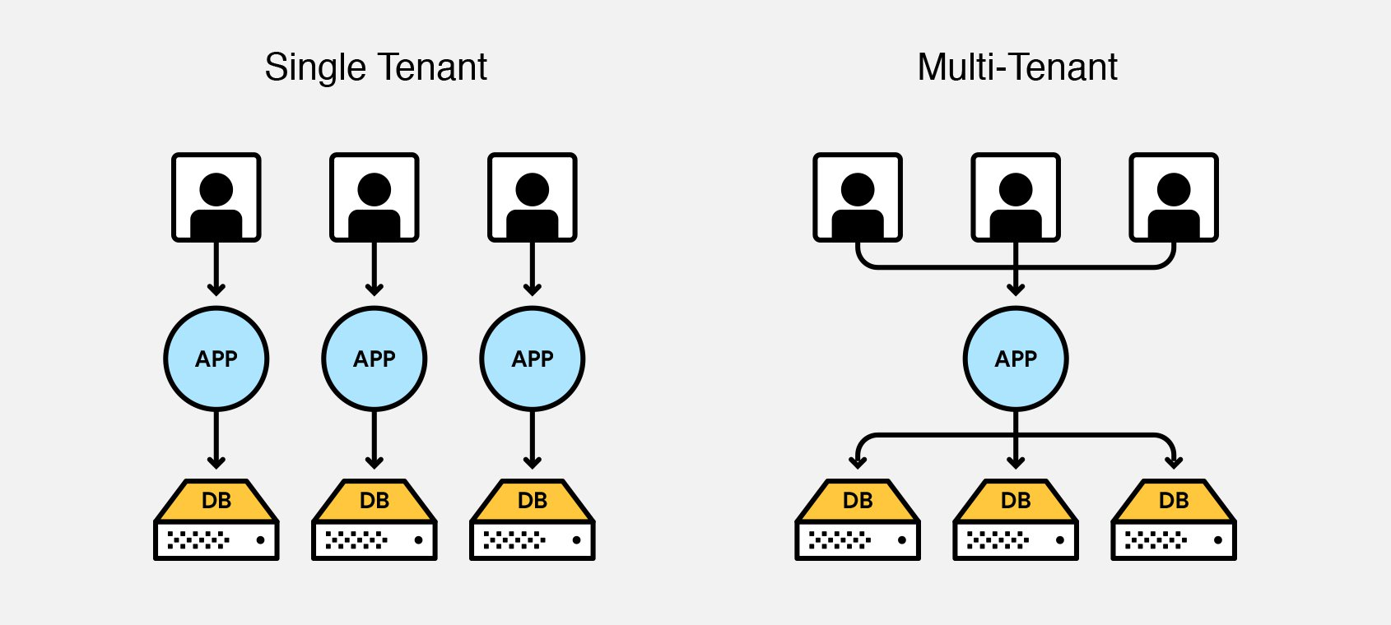
Server architectures

Slide 4
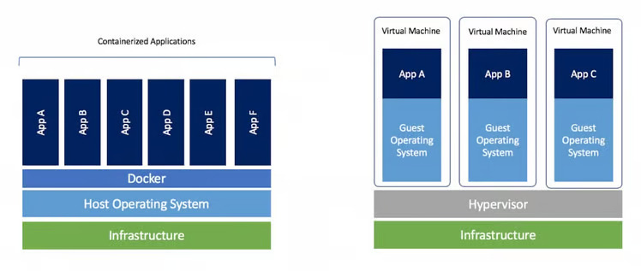
Containerization and Virtualization

Slide 5
Process Types
CPU bound | I/O bound
Spends the majority of its time and resources performing computations or tasks that require significant processing power. | Spends the majority of its performing input/output (I/O) operations.
Video Encoding Complex Scientific Simulations | File Copying Database Queries

Slide 6
CPU Bound Processes
Leibniz's formula for Calculating π
π/4 = (1/1) - (1/3) + (1/5) - (1/7) + …
R = (1/1) - (1/3) + (1/5) - (1/7) + …
π = R x 4

Slide 7
Leibniz's formula for Calculating π
R = 1 - (1/3) + (1/5) - (1/7) + …
R |  | iterations
R = | 0 + 1/1 | i=1 | n
R = | 0 + 1/1 - 1/3 | i=2
R = | 0 + 1/1 - 1/3 + 1/5 | i=3
R = | 0 + 1/1 - 1/3 + 1/5 - 1/7 | i=4

Slide 8
Leibniz's formula for Calculating π
R = 1 - (1/3) + (1/5) - (1/7) + …
1 term :
Numerator / Denominator
Numerator = (-1)^(i+1)
Denominator = 2 x i -1 where i = 1, 2, 3,...

Slide 9
Leibniz's formula for Calculating π
Algorithm
R = 0
i = 1
For n number of iterations perform
R = R + (-1)^(i+1) / 2 x i -1
i++
π = R x 4

Slide 10
ExecutorService and Callable Interface
Java Concurrency API - Utility classes commonly useful in concurrent programming.
Executor - A simple interface that contains a method called execute() to launch a task specified by a Runnable object.
ExecutorService - A sub-interface of Executor that adds functionality to manage the lifecycle of the tasks and provides a submit() method whose overloaded versions can accept a Runnable as well as a Callable object.
ScheduledExecutorService - A sub-interface of ExecutorService with adds functionality to schedule the execution of the tasks.

Slide 11
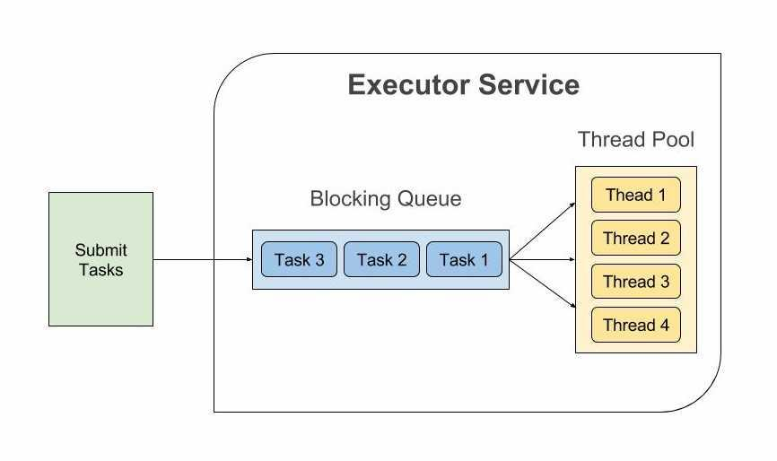
ExecutorService

Slide 12
Callable Interface
@FunctionalInterface
public interface Runnable
@FunctionalInterface
public interface Callable<V>

Slide 13
Future
public interface Future<V> - Future represents the result of an asynchronous computation.
V get() - Waits if necessary for the computation to complete, and then retrieves its result.
V get(long timeout, TimeUnit unit) - Waits if necessary for at most the given time for the computation to complete, and then retrieves its result, if available.
future.get(100, TimeUnit.MILLISECONDS);

Slide 14
Future
public interface Future<V> - Future represents the result of an asynchronous computation.
boolean cancel() - Attempts to cancel execution of this task.
boolean isCancelled() - Returns true if this task was cancelled before it completed normally.
boolean isDone() - Returns true if this task completed.

Slide 15
End of Session 1

